Slide 1
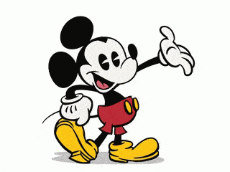
Disneyland reviews sentiment analysis
Pragna Goura, Phuong Le Thien Trinh, Ayat Omar, Tyler Avery

Slide 2

About our Dataset
The dataset contains TripAdvisor reviews about Disneyland's California, Hong Kong, and Paris parks
Features: Review ID, Rating, Reviewer’s origin, and which Disneyland park they visited​
Instances(train, test split): 80% for training, 20% for testing
Size: 42,565 reviews (31.2MB)

Slide 3
OBJECTIVE
An attempt to perform sentiment analysis on Disneyland reviews using various language processing (NLP) techniques and machine learning models.
This project provides a comprehensive analysis of Disneyland reviews and offers valuable insights into customer satisfaction and experience.
The project covers several aspects, including exploratory data analysis (EDA), Wordcloud, sentiment analysis using VADER, TextBlob, and Hugging Face, and sentiment classification using logistic regression models.

Slide 4
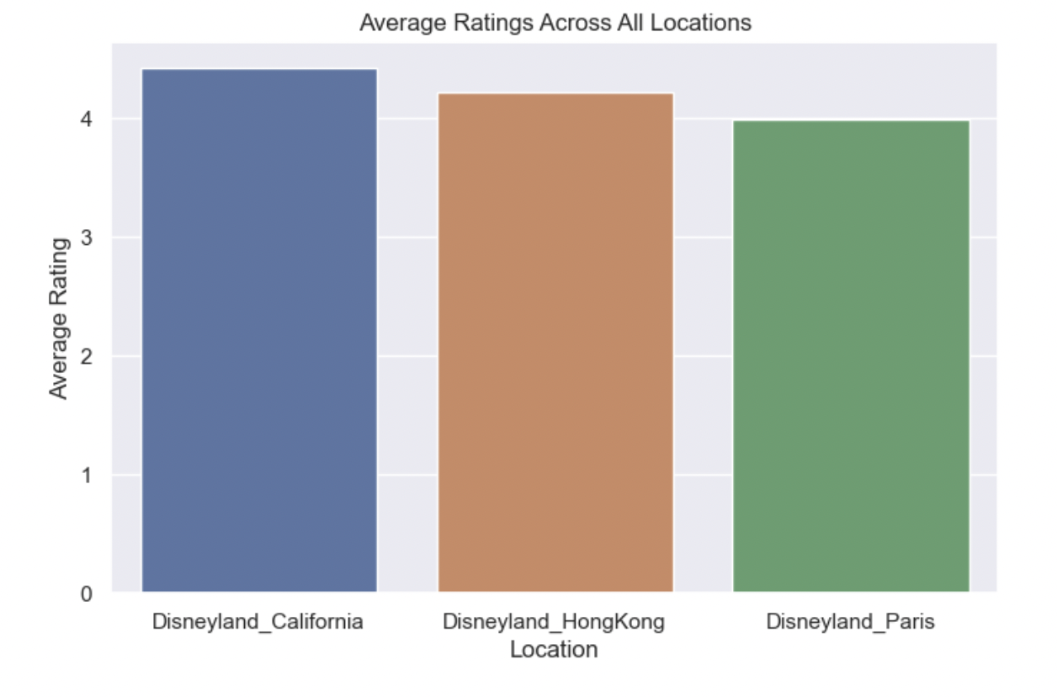
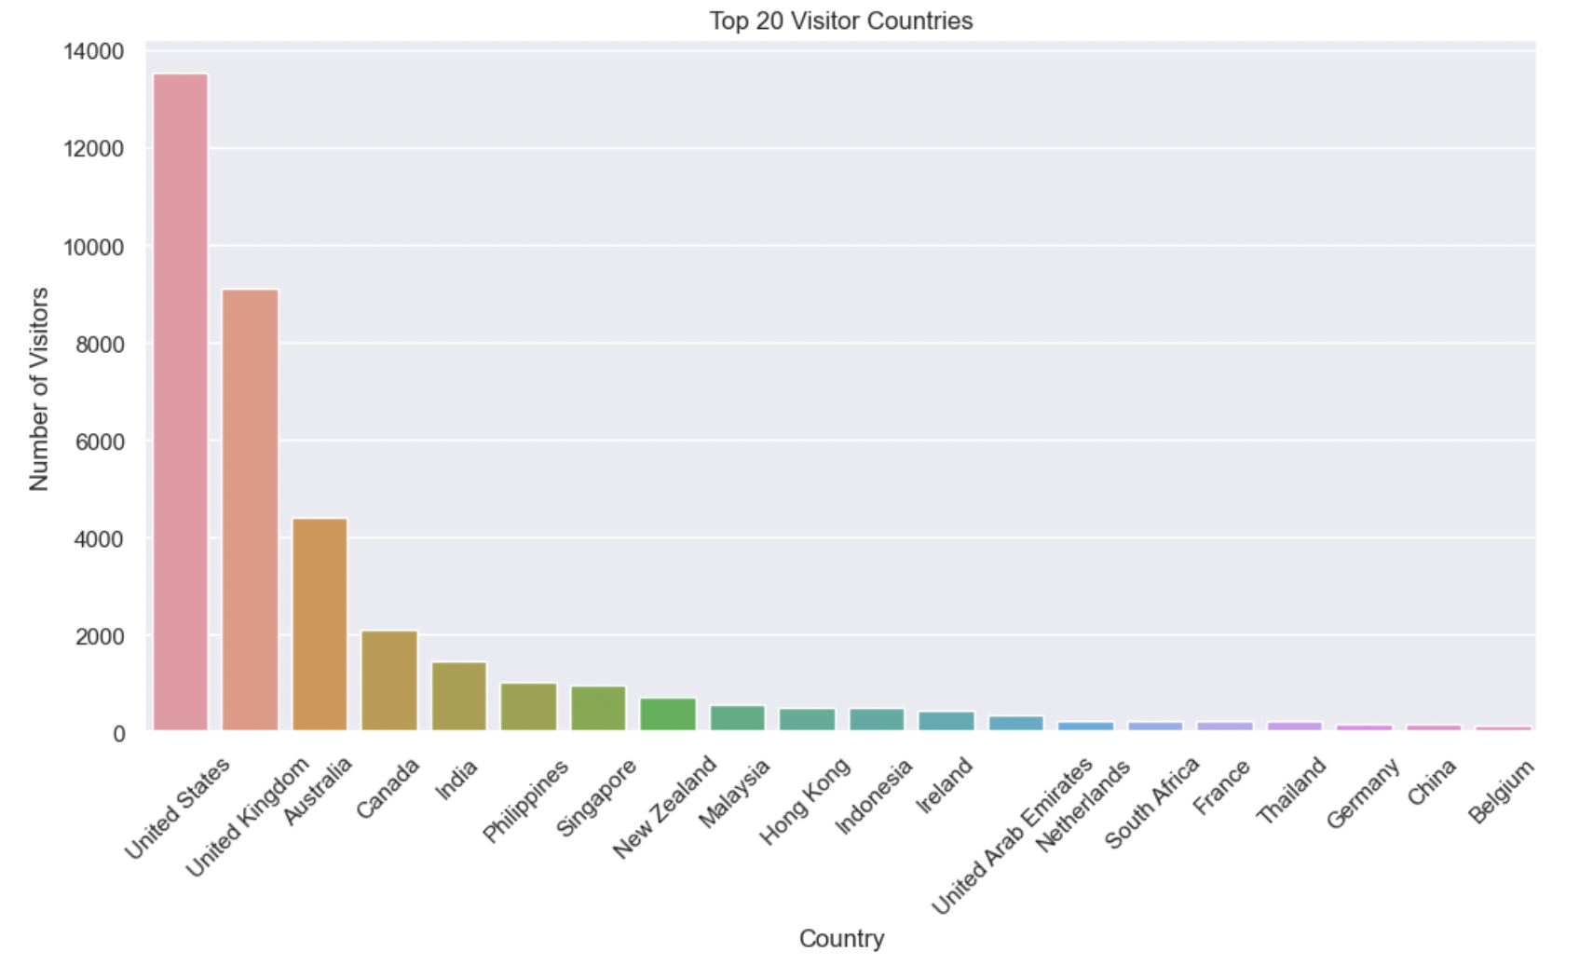
EDA
In our exploratory data analysis, we paid close attention to the location of reviews, as well as the average ratings of the three parks per year. We also created frequency metrics for out-of-country visitors.

Slide 5
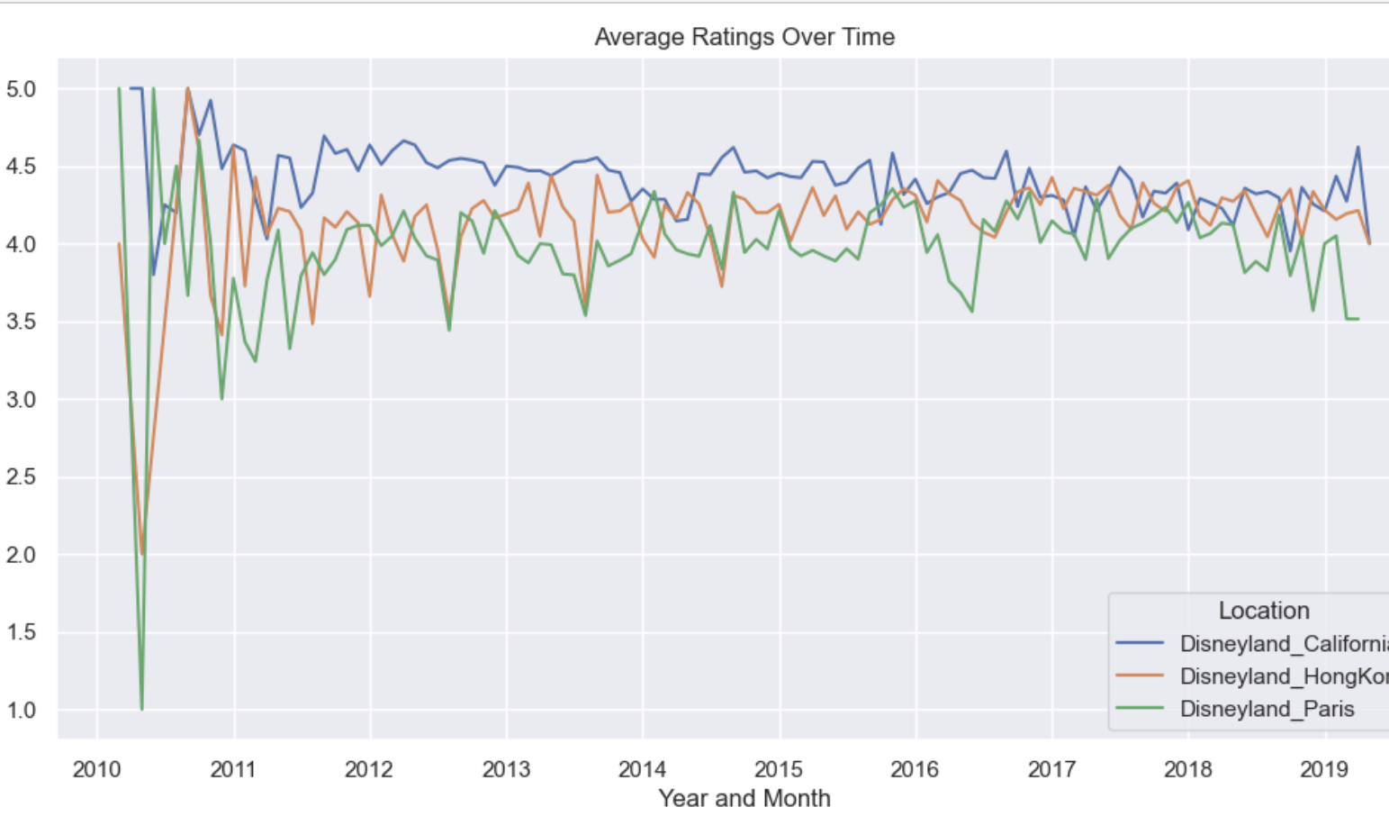
eda
We learned vital information about Average Rating Over Time:
California keeps a rating of 4.41/5
Hong Kong keeps a score of 4.20/5
Lastly Paris' score is 3.96/5
This meant there was a positive comment in the ratings, which we could further prove as we test our models.

Slide 6
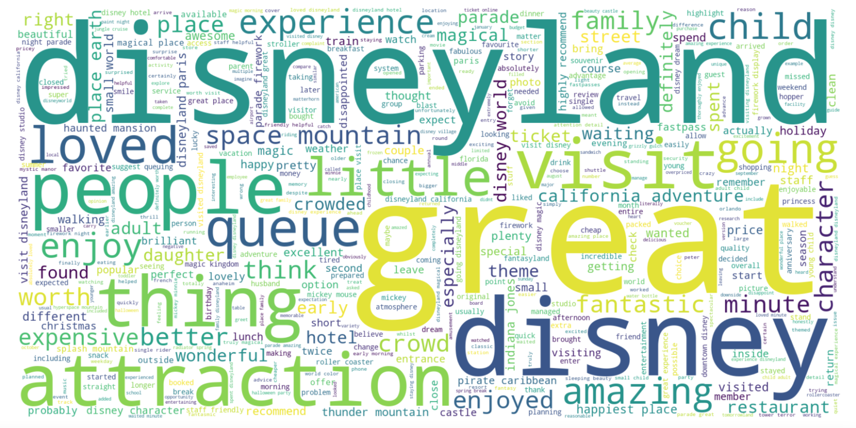
Word cloud
Using the English lexicon as a base, we loaded in our reviews. From this, we used Spacy and NLTK to create 382 different Stopwords.
Creating Word Clouds for each rating category to visualize the most frequently used words in the reviews

Slide 7
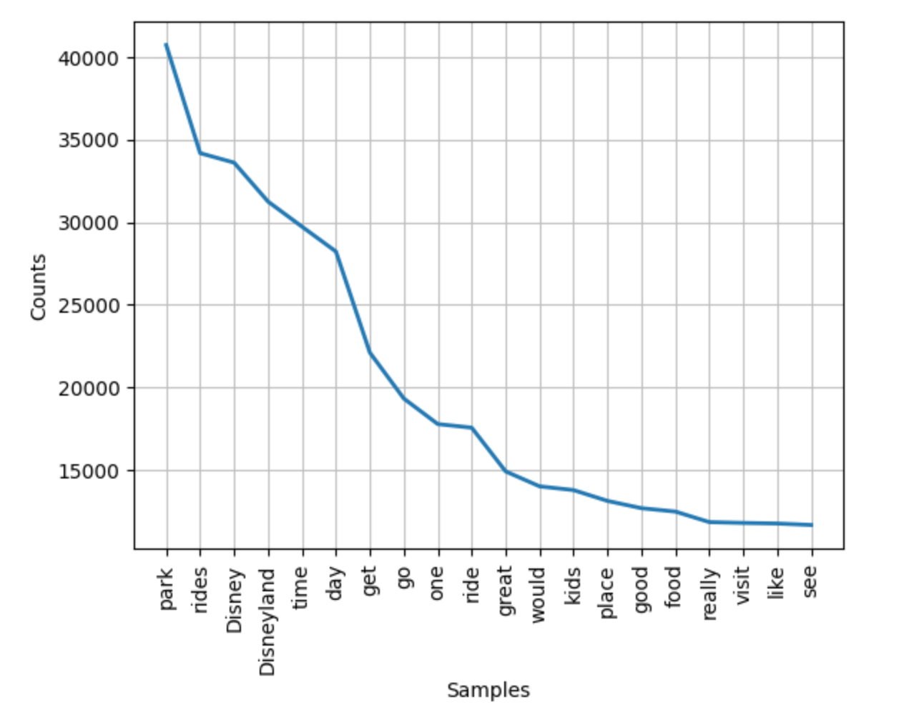

NLtk
Using NLTK library to show which word was frequently using in the comment and from there we get the general sentiment analysis and remove some character, punctuation and stopword.

Slide 8
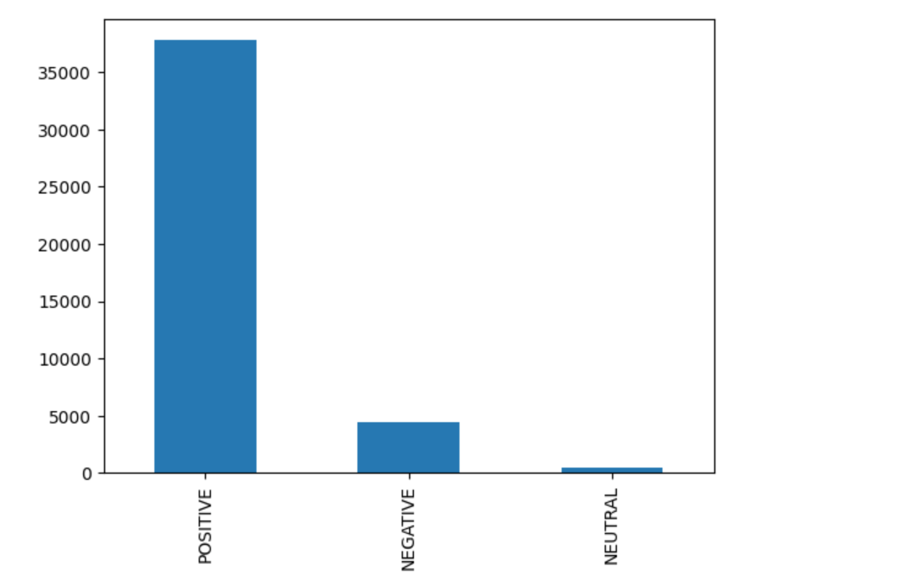
NLTK
NLTK (Natural Language Toolkit) is a popular Python library used for natural language processing tasks such as sentiment analysis. NLTK's sentiment analysis module provides methods for extracting sentiment scores from text data.

Slide 9

Vader and text blob
Both are popular Python libraries for performing sentiment analysis on text.
VADER is a rule-based sentiment analysis tool that is designed to work well with social media text, which can contain slang, emoticons, and other informal language
TextBlob, on the other hand uses a machine learning approach to sentiment analysis, which means that it trains a classifier on a labeled dataset to predict the sentiment of a given text.

Slide 10
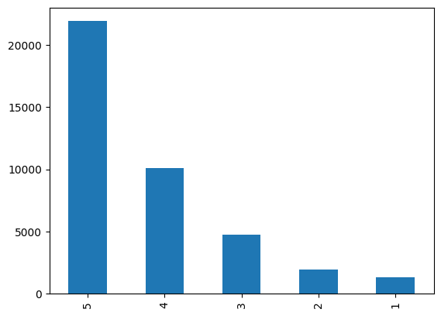
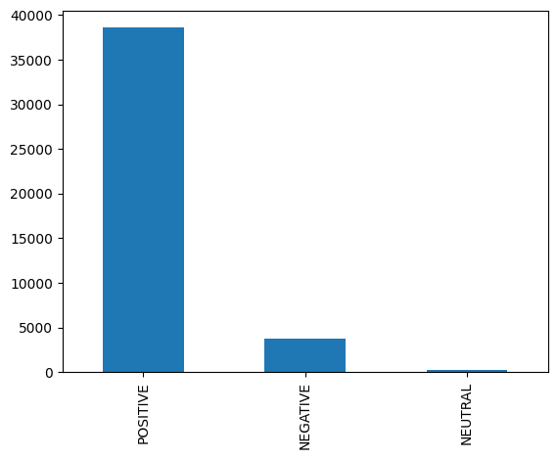
Textblob
With TextBlob, we loaded a list of the reviews, and it calculated the polarity and subjectivity scores accordingly.
Sum of each numbered review out of 5
# Of Positive & Negative Reviews

Slide 11
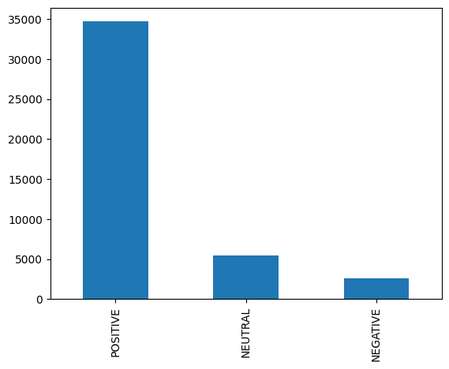
vader
The process for Vader scoring is similar to TextBlob, in that the reviews are stored in a dictionary and evaluated, except the scores are derived from a compound score.
Sum of each review score out of 5
Positive/Negative/Neutral Reviews Counts

Slide 12
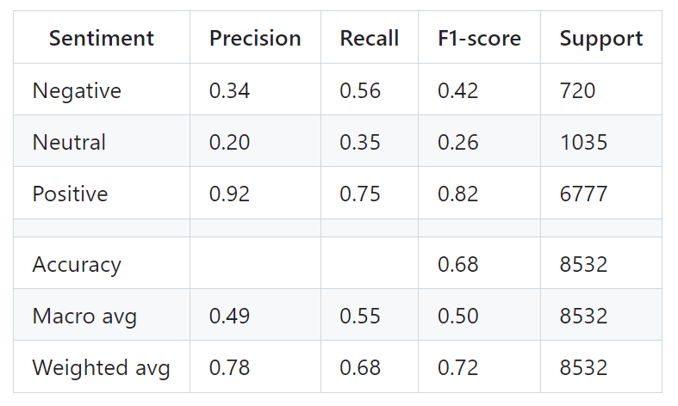
Vader and TexTblob classification report
Using Logistic Regression Model for training and testing the Vader and TextBlob sentiment

Slide 13
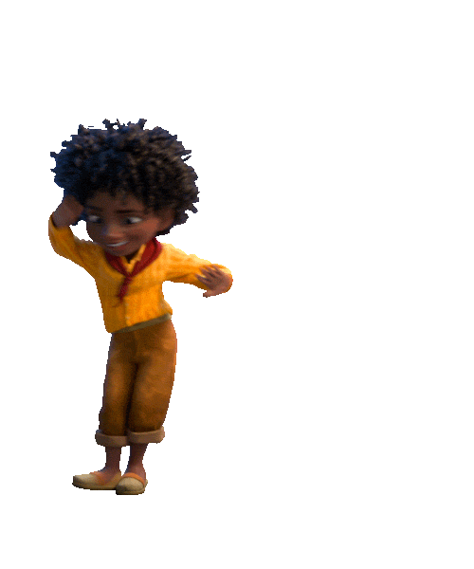
Hugging Face
Hugging Face is a company that develops open-source software and tools for natural language processing (NLP). They are known for creating the Transformers library, which is one of the most popular open-source libraries for NLP tasks.
Hugging Face also provides a variety of other tools and services for NLP, including a platform for hosting and sharing trained models called the Hugging Face Hub

Slide 14

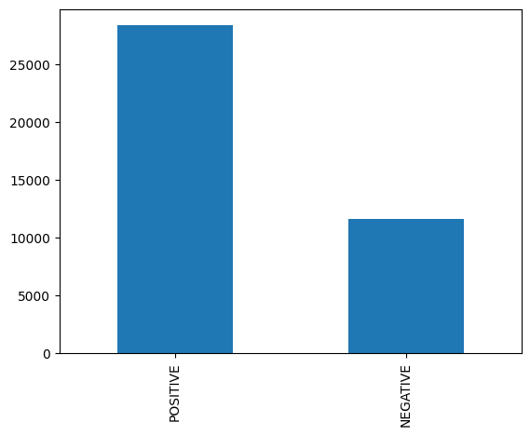
Hugging Face
Using the ‘pipline()’ function and a pretrained model from the Hugging Face Hub
The model used: DistilBERT
Took significantly longer than the VADER and TextBlob
# Of Each Given Rating Out of 5
# Of Positive & Negative Words

Slide 15
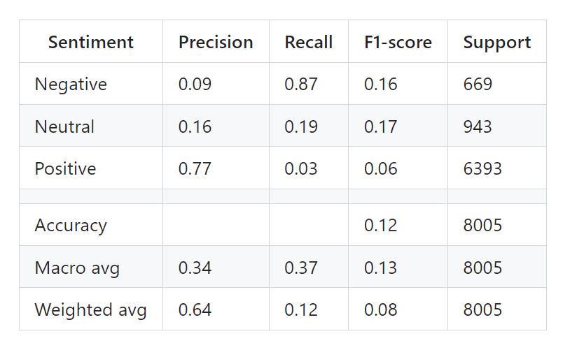
hugging face classification report
Using Logistic Regression model.
Applying SMOTE to balance the classes
Precision values for negative and neutral are significantly lower than positive

Slide 16
Conclusion
Accuracy
VADER and TextBlob model achieved an accuracy of 0.68
Hugging Face model had an accuracy of 0.12.
Precision in classifying positive and negative sentiments
The VADER and TextBlob: 0.34 and 0.92, respectively.
The Hugging Face model struggled to classify positive sentiment, as indicated by the low precision and F1-score. This model might not be well-suited for this specific dataset or problem.
The VADER and TextBlob based model performed significantly better than the Hugging Face based model.

Slide 17
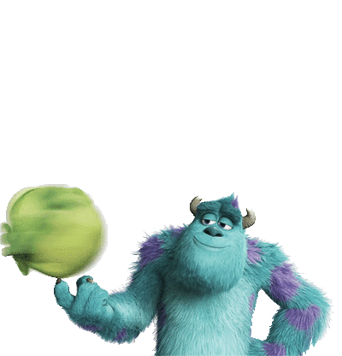
future work
Experiment with other classification algorithms such as Random Forest or SVM to improve the sentiment classification.
Perform a more comprehensive feature engineering process to identify other potentially informative features for sentiment classification.
Explore more advanced deep learning models, such as BERT, to perform sentiment analysis directly on the text data.

Slide 18
Citations
Hugging Face Hub: https://huggingface.co/models
Hugging Face Pretrained model used: https://huggingface.co/distilbert-base-uncased-finetuned-sst-2-english
Useful videos used on understanding Hugging Face: https://www.youtube.com/watch?v=GSt00_-0ncQ
Vader and TextBlob model used: https://github.com/MarshDee/DisneyNLP/blob/main/Disneyland%20-%20Vader%20Sentiment%20Analysis%20%26%20More%20EDA.ipynb
Video for scraping data and applying wordcloud model: https://www.youtube.com/watch?v=AykxRJZXbfc

Slide 19

THANK YOU

